Slide 1
PAML Final Project Presentation
May 15th, 2023
Ayush Kris, Nathan Morris, Yujin Choi and Alexander Ham

Slide 2
Introduction
Motivation and Background:
Bone marrow transplants are a complex medical procedure often used to treat malignant diseases, such as leukemia and lymphoma, as well as non-malignant diseases, like thalassemia and immunodeficiency disorders in children.
This procedure has a high risk of complications, leading to worse post-operative outcomes. Therefore, it is important to assess the risk factors before the surgery and give the patient the treatment that will give the best outcome.

Slide 3
Introduction (cont.)
Technical Focus:
Our proposed approach will use machine learning methods, specifically logistic regression, to predict the clinical outcome of bone marrow transplants in children. Pre-operative information includes: recipient/donor characteristics (gender, blood type, HLA genotyping, CMV status), stem cell source, proportion of matching attributes between recipient and donor, etc.
Impact:
The proposed application has the potential to significantly impact the clinical outcomes of bone marrow transplant procedures by identifying potential risk factors before surgery.

Slide 4
BMT Outcome Prediction Background
Prior Work:
Studies have used post-operative information, such as hematopoietic stem and progenitor cell doses (CD34+ protein marker expression), to predict survival of patients and the probability of graft failure or graft-versus-host disease (GVHD) (Kałwak et al, 2010).
Previous work has predicted outcomes of ASCT (autologous, stem cell transplants) of patients using pre-operative data (Berro et al. 2020)
Here, we build upon this work to implement a similar idea to a different type of transplant between donors and recipients, only using the pre-operative data.
Machine Learning Pipeline:
Our pipeline will consist of four main stages: data exploration, preprocessing, model training and evaluation and deployment.

Slide 5
Project objective:
Train classifier to predict mortality to better understand BMT risk factors

Slide 6
Data Background
Dataset: Bone Marrow Transplant: children dataset
Datatype: Numerical and Categorical
Quantity: 187 instances, 39 attributes
Year Released: 2019
Source: UCI Machine Learning Repository
Ground Truth Labels are Provided: survival_time and survival_status

Slide 7
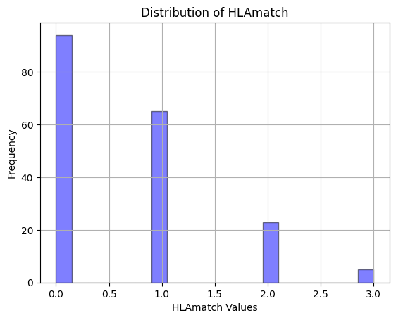
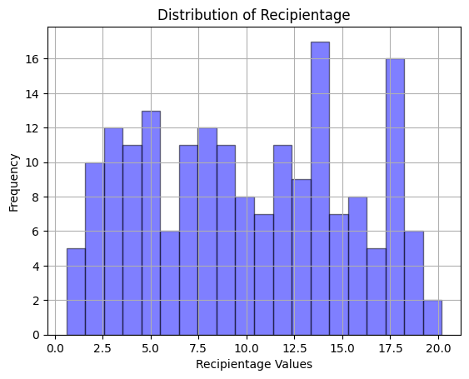
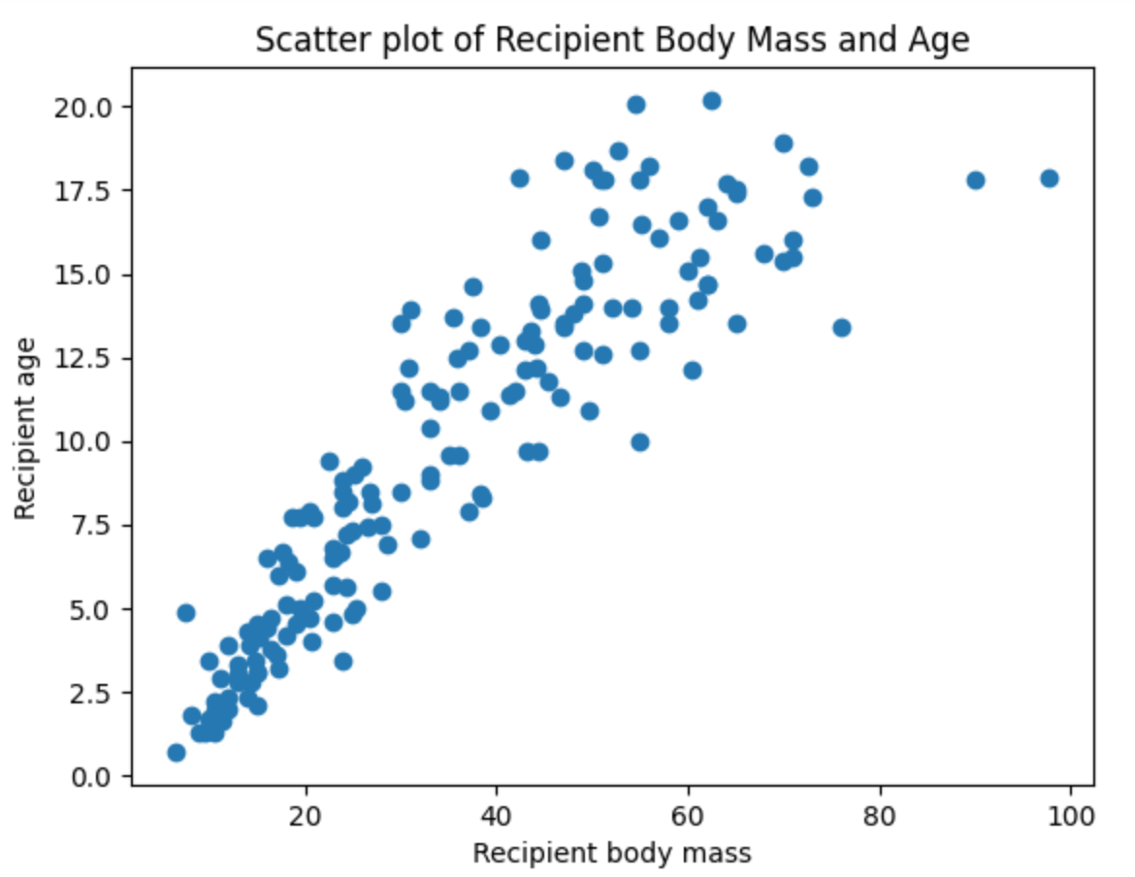
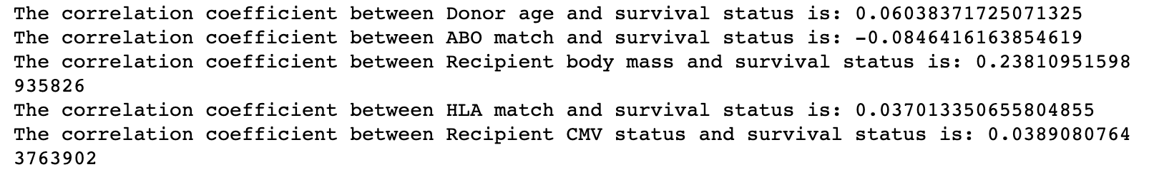
Data Exploration
Used histograms and box plots to understand distribution of numerical and categorical attributes
Explored correlations
Data Preprocessing
Eliminated attributes related to postoperative metrics
One-hot encoded categorical attributes with no directionality (Disease state)
Integer encoded categorical attributes with directionality
Standardized numerical attributes to reduce bias and help interpretability
Eliminated outliers and NaNs

Slide 8
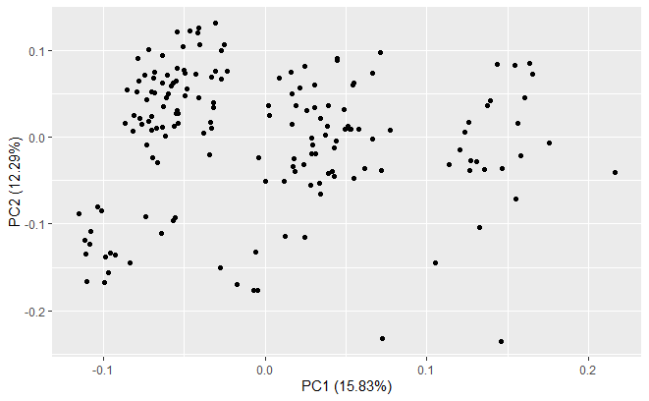
Principal Component Analysis

Slide 9
Performance Metrics for Trained Models
 | Accuracy | Precision | Recall
Logistic Regression (liblinear) | 0.667 | 0.769 | 0.417
Random Forest | 0.627 | 0.778 | 0.292
Logistic Regression (SGD) | 0.569 | 0.571 | 0.333
Logistic Regression (SGD + Grid Search CV) | 0.490 | 0.416 | 0.208

Slide 10
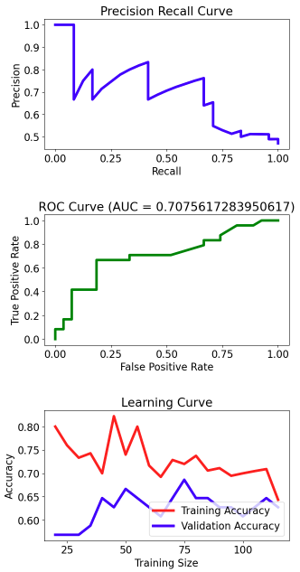
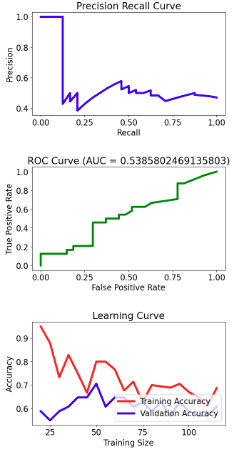
Performance Metrics for Trained Models (cont.)
Logistic Regression (liblinear)
Logistic Regression (SGD + Grid Search CV)

Slide 11
Model Deployment
Form prompts user for patient data input
Output Report
Patient survival risk
Presence of High Risk Factors based on model coefficients

Slide 12
Results vs Expected Outcomes
We expected that the below pre-operative attributes will have the most impact on the clinical outcome:
Risk group, HLA match/mismatch, ABO match/mismatch, Disease type
Clinicians as primarily concerned with HLA matching (Mangum et al. 2022) as it is critical to have a complete match to improve older patient outcome (Nowak 2002).
Our study finds, disease type and ABO blood match to be the most indicative features for predicting patient outcome.
Notes:
https://pubmed.ncbi.nlm.nih.gov/35346535/

Slide 13
Citations
References
Berro, M., Chhabra, S., Piñana, J. L., Arbelbide, J., Rivas, M. M., Basquiera, A. L., Vitriu, A., Requejo, A., Milovic, V., Yantorno, S., Bentolila, G., Garcia, J. J., Castro, M., Palmer, S., Saslavsky, M., Duarte, P., Cerutti, A., Jarchum, G., Tisi Baña, M., … Grupo Argentino de Trasplante de Médula Ósea y Terapia Celular (GATMO-TC). (2020). Predicting mortality after autologous transplant: Development of a novel risk score. Biology of Blood and Marrow Transplantation: Journal of the American Society for Blood and Marrow Transplantation, 26(10), 1828–1832. https://doi.org/10.1016/j.bbmt.2020.06.028
Kałwak, K., Porwolik, J., Mielcarek, M., Gorczyńska, E., Owoc-Lempach, J., Ussowicz, M., Dyla, A., Musiał, J., Paździor, D., Turkiewicz, D., & Chybicka, A. (2010). Higher CD34(+) and CD3(+) cell doses in the graft promote long-term survival, and have no impact on the incidence of severe acute or chronic graft-versus-host disease after in vivo T cell-depleted unrelated donor hematopoietic stem cell transplantation in children. Biology of Blood and Marrow Transplantation: Journal of the American Society for Blood and Marrow Transplantation, 16(10), 1388–1401. https://doi.org/10.1016/j.bbmt.2010.04.001
Mangum, D. S., & Caywood, E. (2022). A clinician’s guide to HLA matching in allogeneic hematopoietic stem cell transplant. Human Immunology, 83(10), 687–694. https://doi.org/10.1016/j.humimm.2022.03.002
Nowak, J. (2008). Role of HLA in hematopoietic SCT. Bone Marrow Transplantation, 42 Suppl 2(S2), S71-6. https://doi.org/10.1038/bmt.2008.288
Notes:
https://www.astctjournal.org/article/S1083-8791(10)00148-5/fulltext

